Slide 1

Continuous Probability Models
MTH 564 – Mathematical Modeling

Slide 2
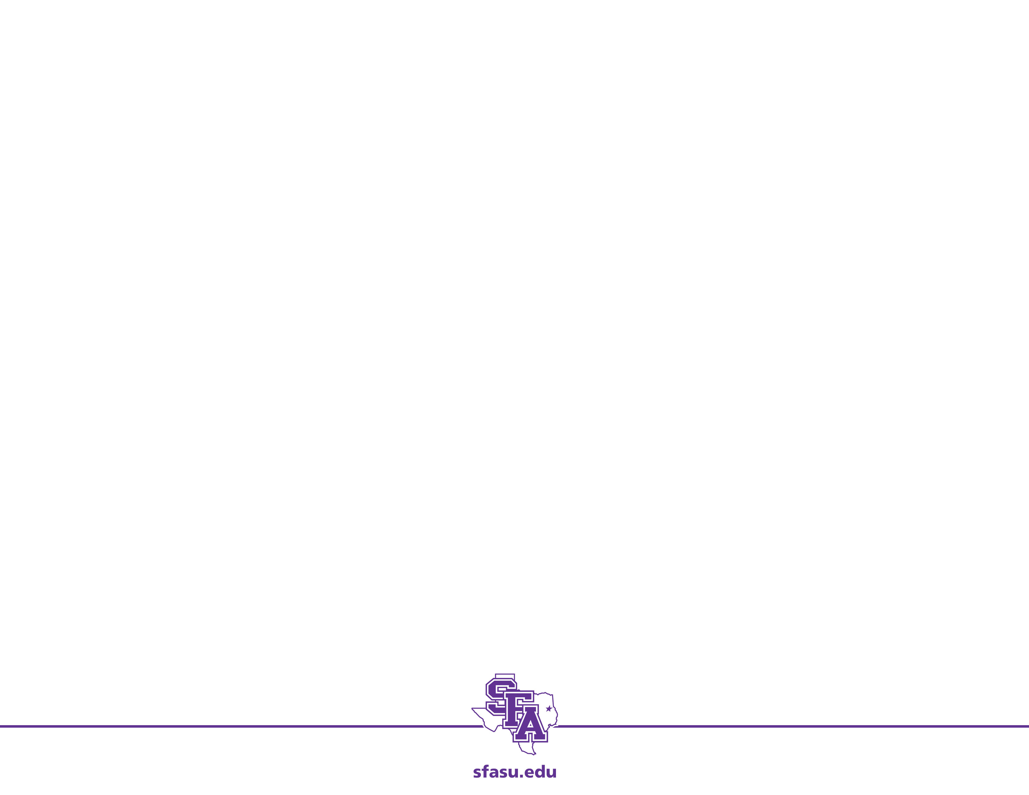
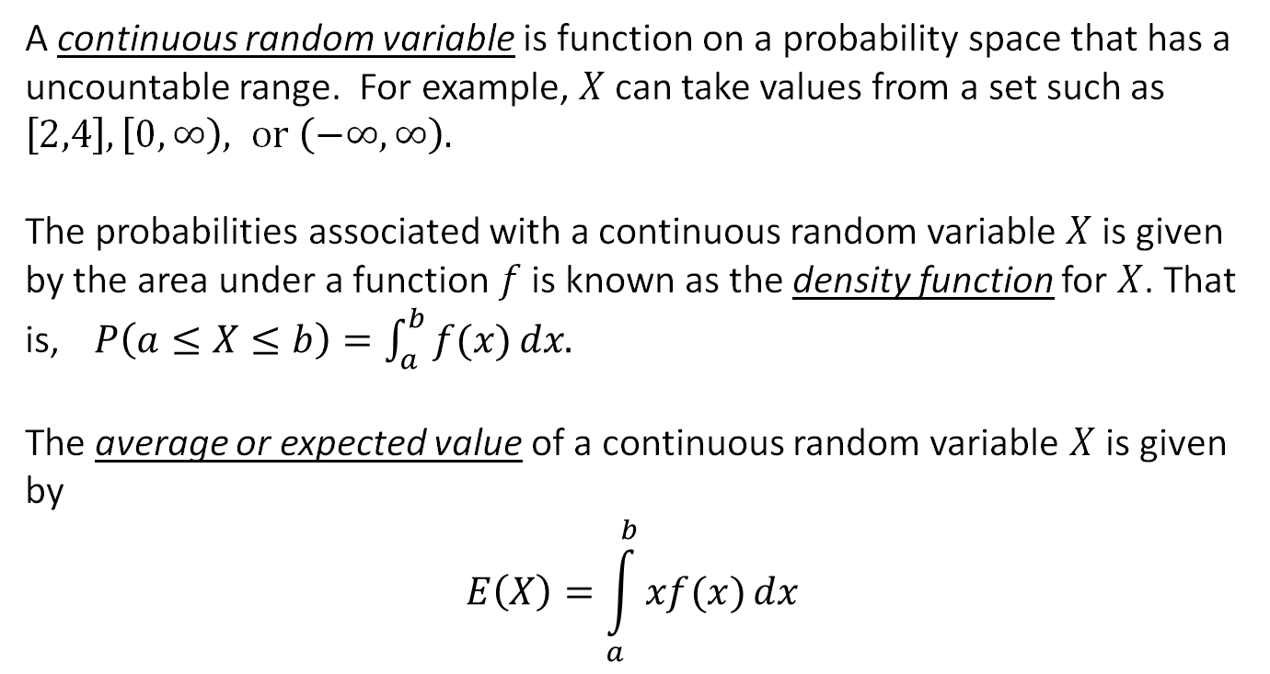
Continuous Probability Models
A continuous random variable is function on a probability space that has a uncountable range. For example, $X$can take values from a set such as $\left[2,4\right], \left[0,∞\right), or \left(−∞, ∞\right).$
The probabilities associated with a continuous random variable $X$ is given by the area under a function $f$ is known as the density function for $X$. That is, $P\left(a≤X≤b\right)=\int_{a}^{b}{f(x)}dx.$
The average or expected value of a continuous random variable $X$ is given by
$$E\left(X\right)=\int_{a}^{b}{xf(x)}dx$$

Slide 3
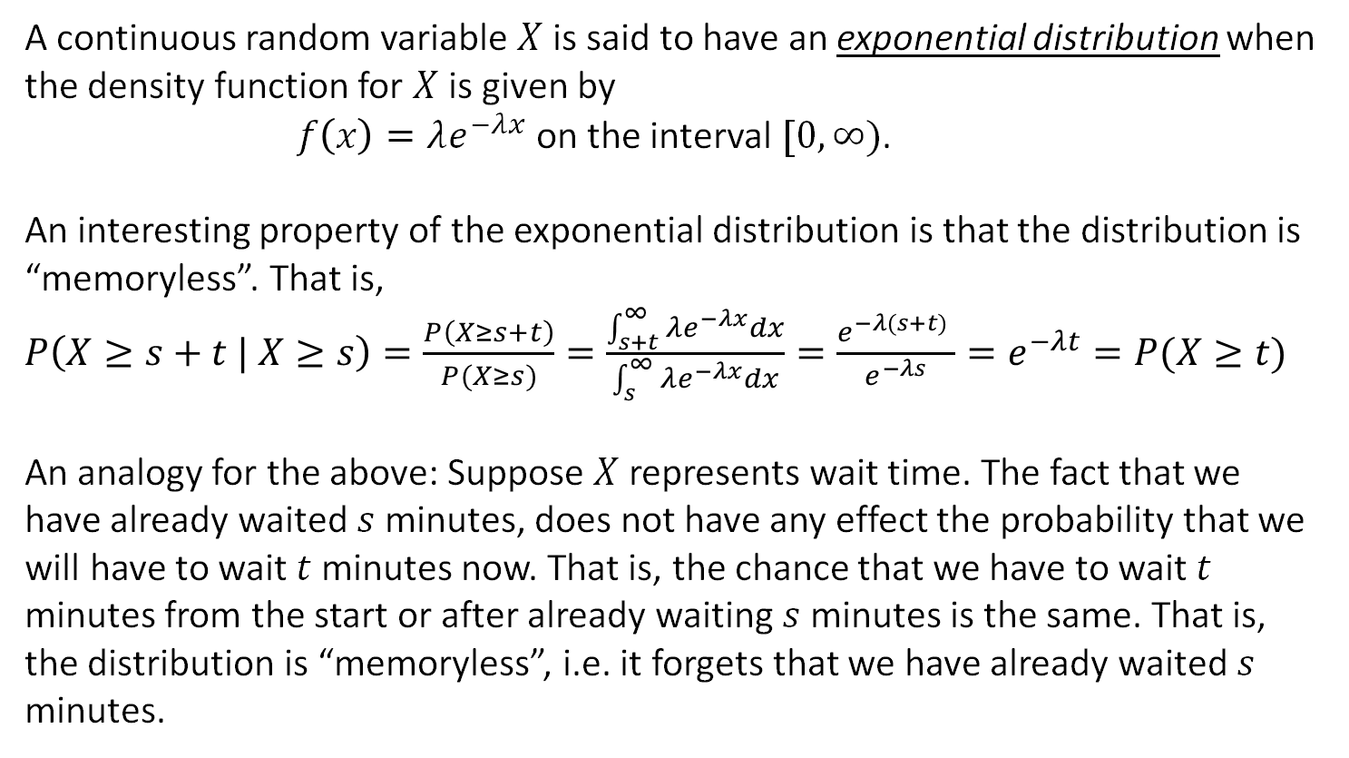
Exponential Distribution
A continuous random variable $X$is said to have an exponential distribution when the density function for $X$ is given by
$f\left(x\right)=λe^{−λx}$ on the interval $[0,∞)$.
An interesting property of the exponential distribution is that the distribution is “memoryless”. That is,
$P\left(X≥s+t | X≥s\right)=\frac{P\left(X≥s+t\right)}{P(X≥s)}=\frac{\int_{s+t}^{∞}{λe^{−λx}}dx}{\int_{s}^{∞}{λe^{−λx}}dx}=\frac{e^{−λ(s+t)} }{e^{−λs}}=e^{−λt}=P(X≥t)$
An analogy for the above: Suppose $X$ represents wait time. The fact that we have already waited $s$ minutes, does not have any effect the probability that we will have to wait $t$ minutes now. That is, the chance that we have to wait $t$ minutes from the start or after already waiting $s$ minutes is the same. That is, the distribution is “memoryless”, i.e. it forgets that we have already waited $s$ minutes.

Slide 4
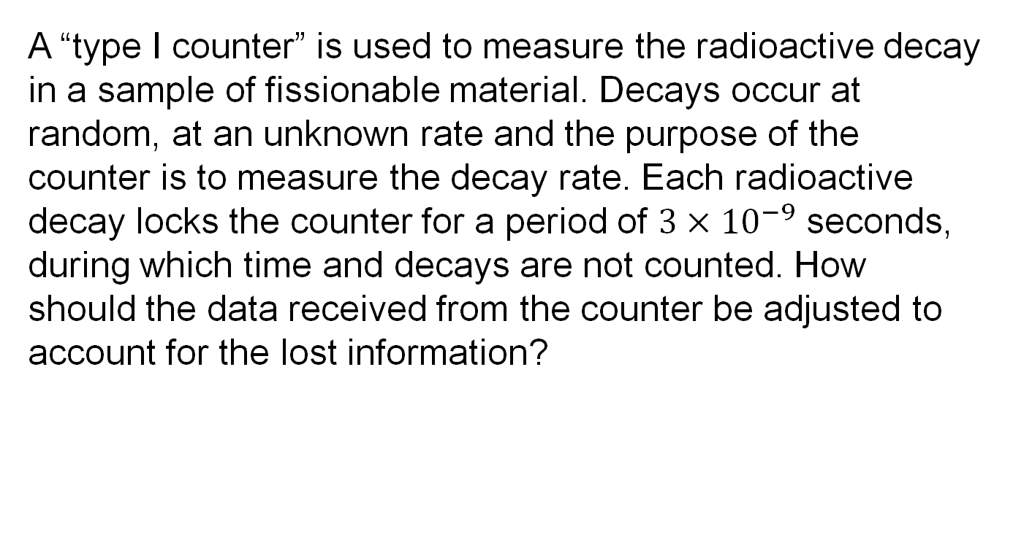
Problem
A “type I counter” is used to measure the radioactive decay in a sample of fissionable material. Decays occur at random, at an unknown rate and the purpose of the counter is to measure the decay rate. Each radioactive decay locks the counter for a period of $3×{10}^{−9}$ seconds, during which time and decays are not counted. How should the data received from the counter be adjusted to account for the lost information?

Slide 5
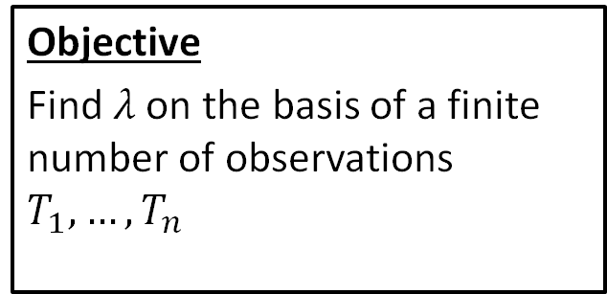
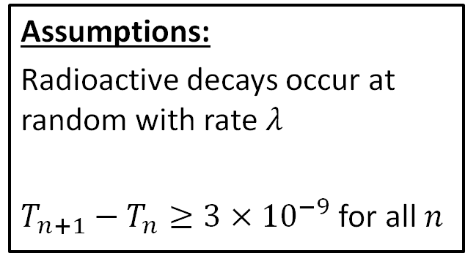
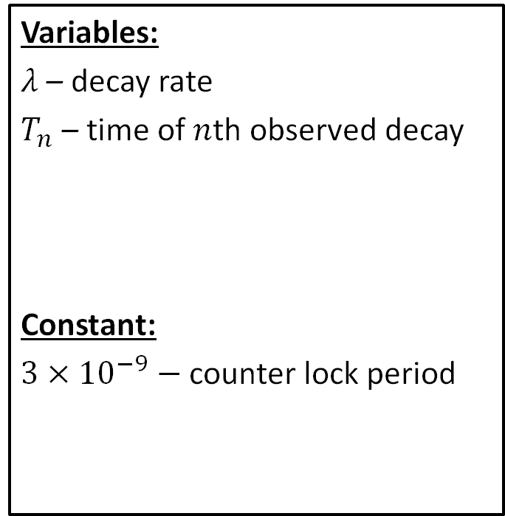
Step 1: Frame the problem
Variables:
$λ$ – decay rate
$T_{n}$ – time of $n$th observed decay
Constant:
$3×{10}^{−9}−$ counter lock period
Assumptions:
Radioactive decays occur at random with rate $λ$
$T_{n+1}−T_{n}≥3×{10}^{−9}$ for all $n$
Objective
Find $λ$ on the basis of a finite number of observations $T_{1}, …, T_{n}$

Slide 6
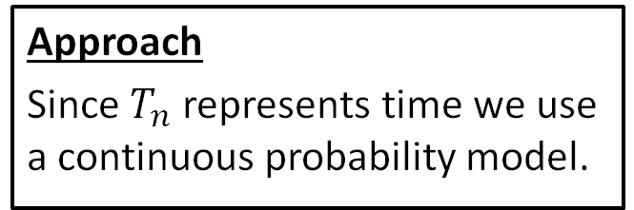
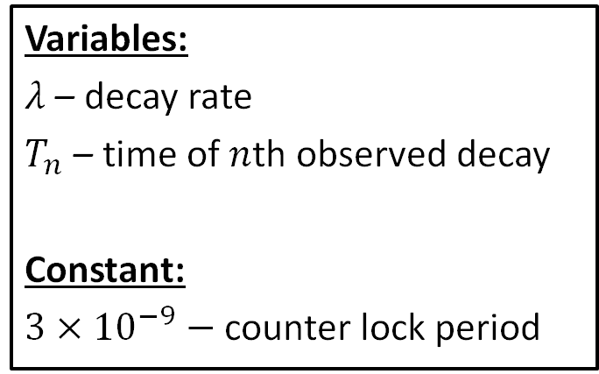
Step 2: Select the modeling approach
Variables:
$λ$ – decay rate
$T_{n}$ – time of $n$th observed decay
Constant:
$3×{10}^{−9}−$ counter lock period
Assumptions:
Radioactive decays occur at random with rate $λ$
$T_{n+1}−T_{n}≥3×{10}^{−9}$ for all $n$
Objective
Find $λ$ on the basis of a finite number of observations $T_{1}, …, T_{n}$
Approach
Since $T_{n}$ represents time we use a continuous probability model.

Slide 7
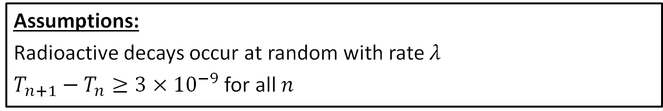
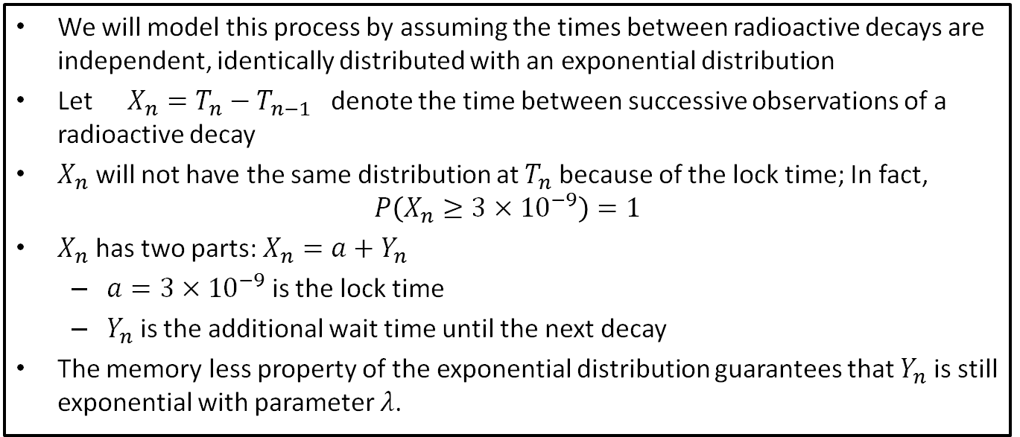
Step 3: Formulate the model
Assumptions:
Radioactive decays occur at random with rate $λ$
$T_{n+1}−T_{n}≥3×{10}^{−9}$ for all $n$
We will model this process by assuming the times between radioactive decays are independent, identically distributed with an exponential distribution
Let $X_{n}=T_{n}−T_{n−1}$ denote the time between successive observations of a radioactive decay
$X_{n}$ will not have the same distribution at $T_{n}$ because of the lock time; In fact, $P\left(X_{n}≥3×{10}^{−9}\right)=1$
$X_{n}$ has two parts: $X_{n}=a+Y_{n}$
$a=3×{10}^{−9}$ is the lock time
$Y_{n}$ is the additional wait time until the next decay
The memory less property of the exponential distribution guarantees that $Y_{n}$ is still exponential with parameter $λ$.

Slide 8
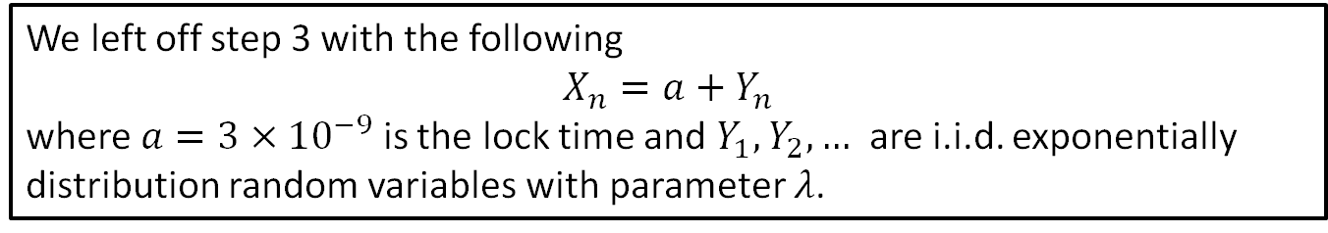
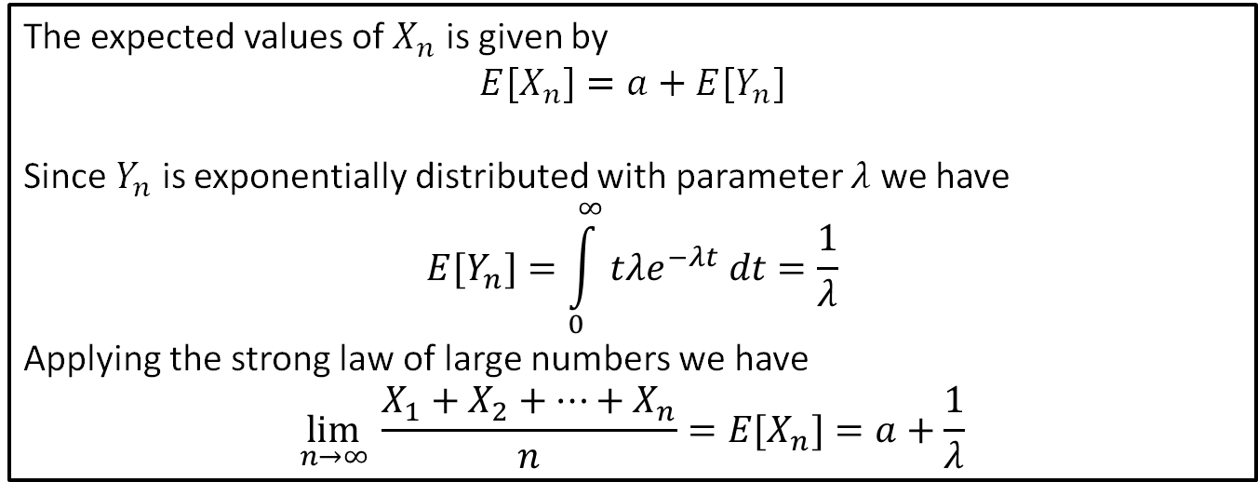
Step 4: Solve the Problem
We left off step 3 with the following
$$X_{n}=a+Y_{n}$$
where $a=3×{10}^{−9}$ is the lock time and $Y_{1}, Y_{2},…$ are i.i.d. exponentially distribution random variables with parameter $λ$.
The expected values of $X_{n}$ is given by
$$E[X_{n}]=a+E[Y_{n}]$$
Since $Y_{n}$ is exponentially distributed with parameter $λ$ we have
$$E[Y_{n}]=\int_{0}^{∞}{tλe^{−λt} dt=\frac{1}{λ}}$$
Applying the strong law of large numbers we have
$$\lim_{n→∞ }\frac{X_{1}+X_{2}+⋯+X_{n}}{n}=E[X_{n}]=a+\frac{1}{λ}$$

Slide 9
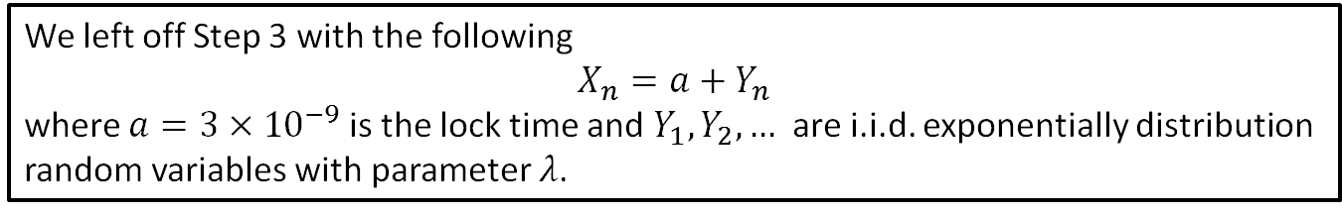
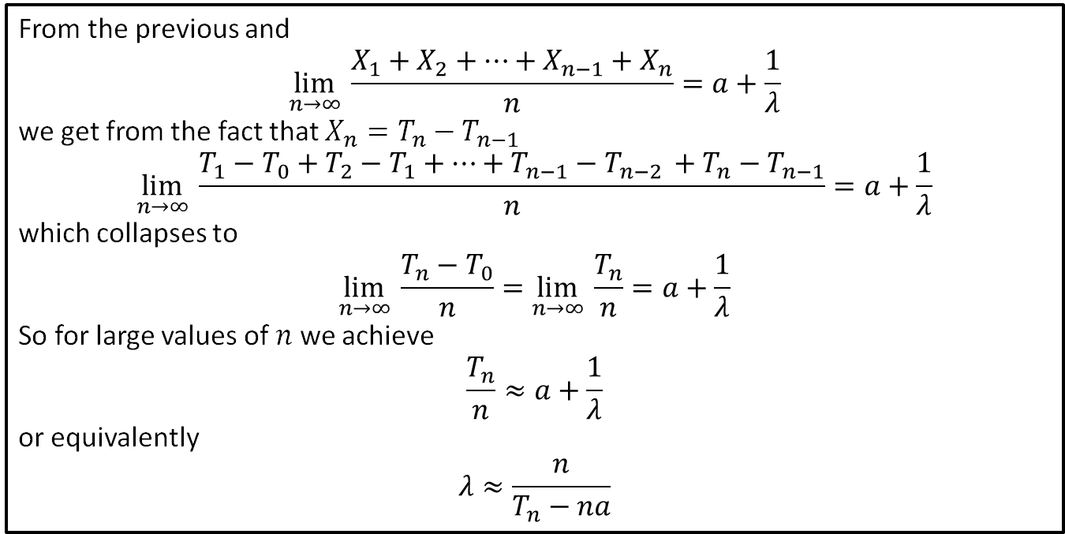
Step 4: Solve the Problem
We left off Step 3 with the following
$$X_{n}=a+Y_{n}$$
where $a=3×{10}^{−9}$ is the lock time and $Y_{1}, Y_{2},…$ are i.i.d. exponentially distribution random variables with parameter $λ$.
From the previous and
$$\lim_{n→∞ }\frac{X_{1}+X_{2}+⋯+X_{n−1}+X_{n}}{n}=a+\frac{1}{λ}$$
we get from the fact that $X_{n}=T_{n}−T_{n−1}$
$$\lim_{n→∞ }\frac{T_{1}−T_{0}+T_{2}−T_{1}+⋯+T_{n−1}−T_{n−2 }+T_{n}−T_{n−1}}{n}=a+\frac{1}{λ}$$
which collapses to
$$\lim_{n→∞ }\frac{T_{n}−T_{0}}{n}=\lim_{n→∞ }\frac{T_{n}}{n}=a+\frac{1}{λ}$$
So for large values of $n$ we achieve
$$\frac{T_{n}}{n}≈a+\frac{1}{λ}$$
or equivalently
$$λ≈\frac{n}{T_{n}−na}$$

Slide 10
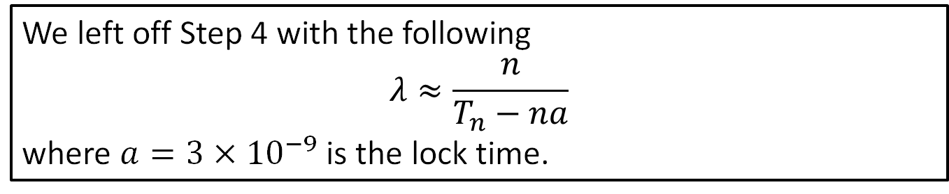
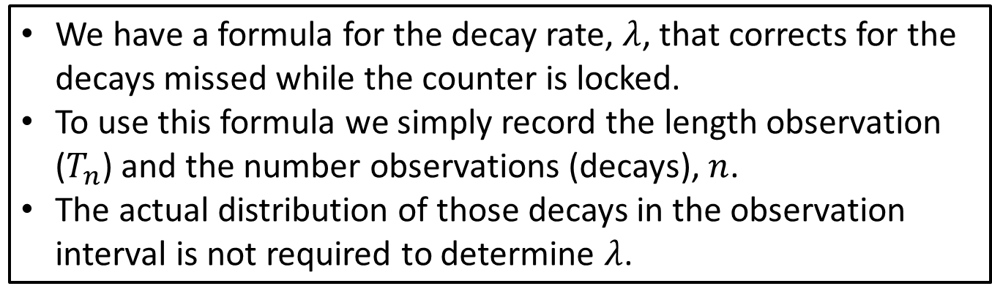
Step 5: Answer the question
We left off Step 4 with the following
$$λ≈\frac{n}{T_{n}−na}$$
where $a=3×{10}^{−9}$ is the lock time.
We have a formula for the decay rate, $λ$, that corrects for the decays missed while the counter is locked.
To use this formula we simply record the length observation ($T_{n}$) and the number observations (decays), $n$.
The actual distribution of those decays in the observation interval is not required to determine $λ$.

Slide 11
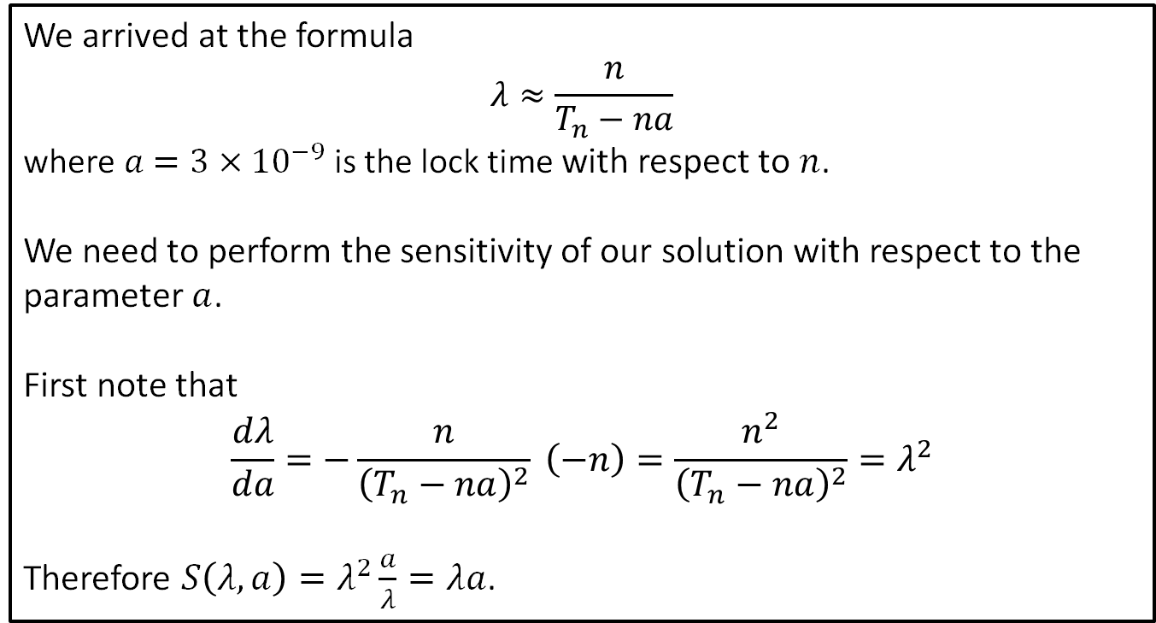
Sensitivity Analysis: Decay Rate
We arrived at the formula
$$λ≈\frac{n}{T_{n}−na}$$
$\text{where} a=3×{10}^{−9} \text{is} \text{the} \text{lock} \text{time}$ with respect to $n$.
We need to perform the sensitivity of our solution with respect to the parameter $a$.
First note that
$$\frac{dλ}{da}=−\frac{n}{{\left(T_{n}−na\right)}^{2}} \left(−n\right)=\frac{n^{2}}{{\left(T_{n}−na\right)}^{2}}=λ^{2}$$
Therefore $S\left(λ, a\right)=λ^{2}\frac{a}{λ}=λa$.

Slide 12
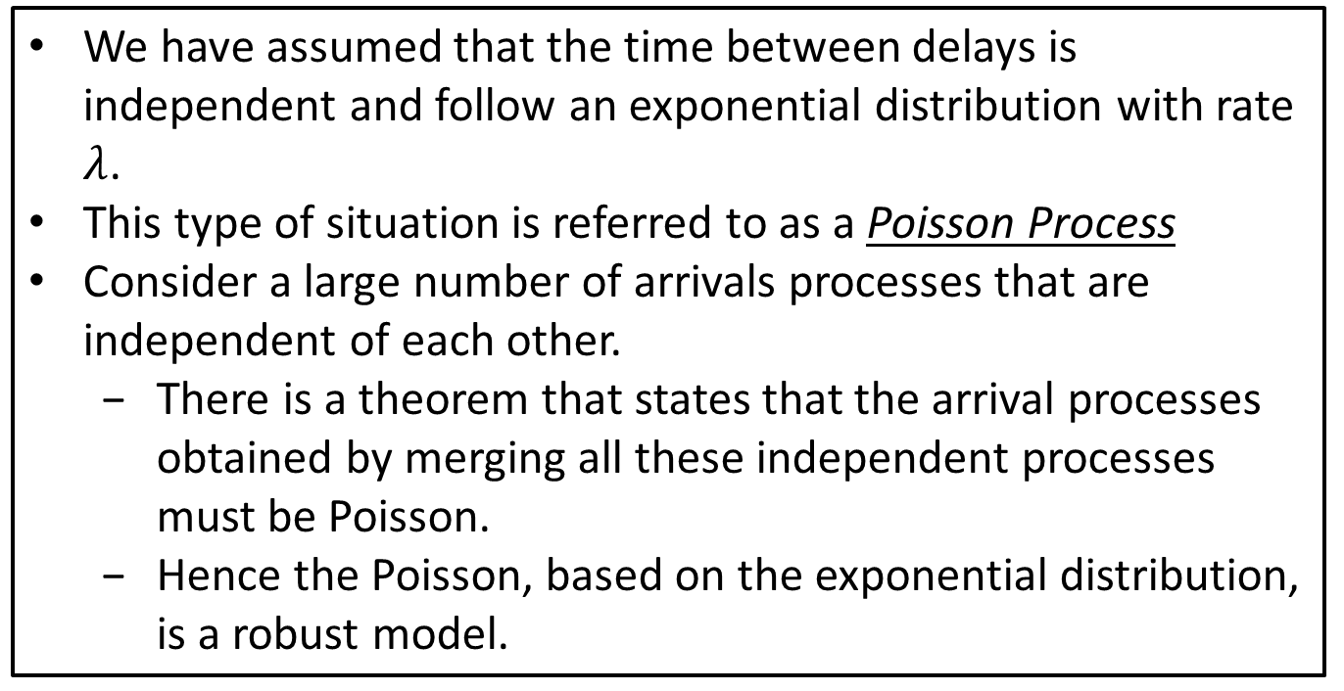
Robustness
We have assumed that the time between delays is independent and follow an exponential distribution with rate $λ$.
This type of situation is referred to as a Poisson Process
Consider a large number of arrivals processes that are independent of each other.
There is a theorem that states that the arrival processes obtained by merging all these independent processes must be Poisson.
Hence the Poisson, based on the exponential distribution, is a robust model.

